Slide 1
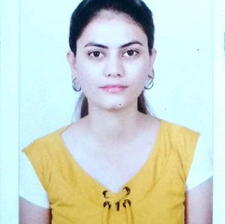

Nikita Tejrao Wankhade
Analyst/Software Engineer
Bachelor of Engineering
Electronic And Telecommunication Engineering 2016– 2019
Mumbai
Skills C ,C++ C# ASP. NET Framework ADO. NET ASP. NET Core MVC Database SQL database – MySQL PostgreSQL Web Technologies HTML5 CSS AddOns GitHub Postman Tools Visual Studio 2019 Visual Studio code Swagger Android Studio Additional Details Leadership Quick Learner Team management
NIKITA.WANKHADE@CAPGEMINI.COM
+91 9765978916
A4
A team player with good communication skills always ready to work for the enrichment of knowledge.
Good problem solver and Logical thinker.
Ready to learn new technologies and implement them to further improve my knowledge.
Hands-on experience in creating Web Applications
with Asp.net and MVC Core.
Movie Management System
Completed end-to-end case study of Movie management system along with Swagger, Fiddler testing using Core MVC, Web API, and MsSql.
AZ – 900 Microsoft Azur Fundamentals Certification at Degreed Platform
Learning AZ- 900 Microsoft Azure Fundamentals from Capgemini Degreed platform.
Trained on Dot Net, SQL Server, Ado.net, Core MVC, Core Web API, Entity Framework

